Slide 1
R.Lusser-Lusser’s Law
J.Bernoulli-law of large numbers (LLN)
P.Chebyshev-Chebyshev inequality
A.Kolmogorov-Kolmogorov axioms

Slide 2
故障数据的统计分析——产品组成零部件故障数百分比
Subsystem | Parts | Failure percentage%
Electrical equipment | Integrated circuit | 77.5
 | Cord | 12.5
 | Joint | 10.0
Flippers | Others | 63.8
 | Fender | 21.8
 | Hydraulic cylinder | 14.4
Hydraulic system | Power equipment | 65.5
 | Hydraulic piping | 20.2
 | Accessories | 14.3
Scalable system
 | Position limit switch | 90.3
 | Cylinder | 9.7

Slide 3
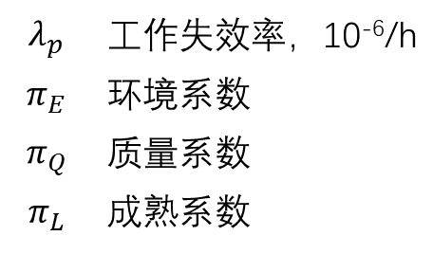
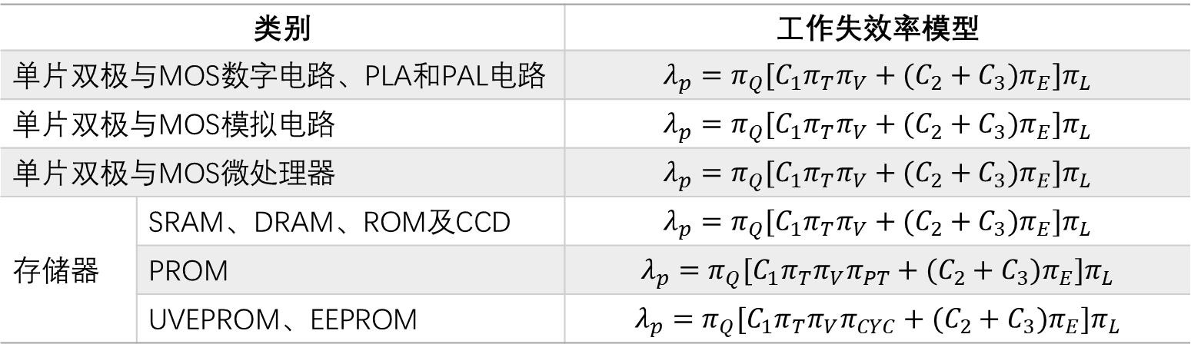
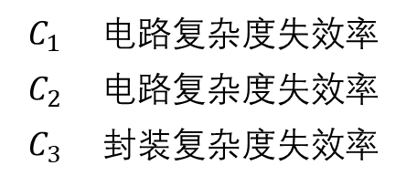
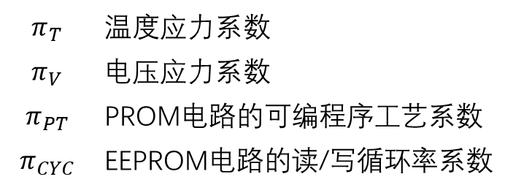
Type |  | Failure model
Monolithic bipolar and MOS digital circuits, PLA and PAL circuits
Monolithic bipolar and MOS analog circuits
Monolithic bipolar and microprocessor
Memory | SRAM, DRAM, ROM, CCD
 | PROM
 | UVEPROM, EEPROM
 | Failure rate，10⁻⁶/h
 | Environmental coefficient
 | Quality coefficient
 | Maturity coefficient
 | Temperature stress coefficient
 | Voltage stress coefficient
 | Programmable process coefficient of PROM circuits
 | Read/Write circulation rate coefficient of EEPROM circuits
 | Circuit complexity coefficient
 | Circuit complexity coefficient
 | Package complexity coefficient

Slide 4
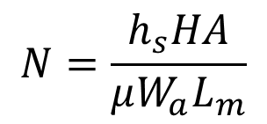
1
t_{c}
The oxide layer thickness of chip
Gate oxide breakdown E model
Design parameter
V_{g}
Gate voltage of oxide layer
C
Breakdown factor of E model
Material parameter
A
Field acceleration factor of E model
E_{a}
Activation energy of breakdown
Life span
Load parameter
T_{g}
Work temperature of chip
2
Threshold parameter
h_{s}
Maximum allowable of abrasion
Archard abrasion life model
H
Material hardness
$$N=\frac{h_{s}HA}{μW_{a}L_{m}}$$
Material parameter
μ
Coefficient of kinetic fiction
A
Contact area of wear surface
Abrasion time
Load parameter
W_{a}
Positive pressure of contact surface

Slide 5

General type of performance degradation model
P | Performance parameter vector | x | Input parameter vector
t | time | P_{th} | Performance parameter threshold
振动冲击应力模型（一阶冲击振动）
Input paramenter
parameter | Parameter meaning | dimension
 | Parts length | mm
 | Package relevant parameter | none
 | Thickness or altitude of PCB | mm
 | 平行于元器件长边的PCB边缘长度 | mm
 | Inherent frequency | Hz
 | 元器件处电路板相对曲率 | none
Time irrelevance
当 时，失效发生
Z_{allow} | 理想最大位移
Z_{max} | 实际最大位移

